Slide 1

Just-in-Time Intervention
Hosuk Choi, Matt Yang, Mia Zhao, Attush Dhakal,
Aashay Amin, Saurabh Chatterjee, Rachel Paul

Slide 2
Introduction

Slide 3
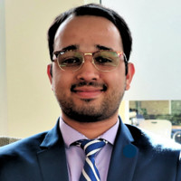
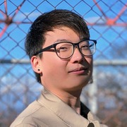
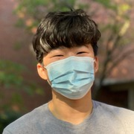

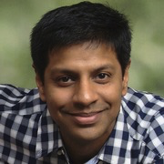
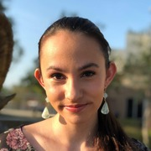
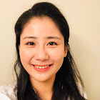
Meet the Team!
Attush
Hosuk
Matthew
Aashay
Saurabh
Rachel
Mia

Slide 4
Background on Project
Project inspired by an analysis conducted by Gardner and Brooks (UMich) in 2018, who laid the framework for attempting to predict student success in MOOCs (https://arxiv.org/abs/1711.06349)
In their paper, they used raw data sources from many MOOCs platforms.
Clickstream data
Assignment data
Forum data
We have access to many similar datasets via Georgia Tech’s numerous online courses
Our team’s ultimate goal is to not only gain insight into what drives student success, but also to be able to easily present our results to professors and students on a class-by-class basis

Slide 5
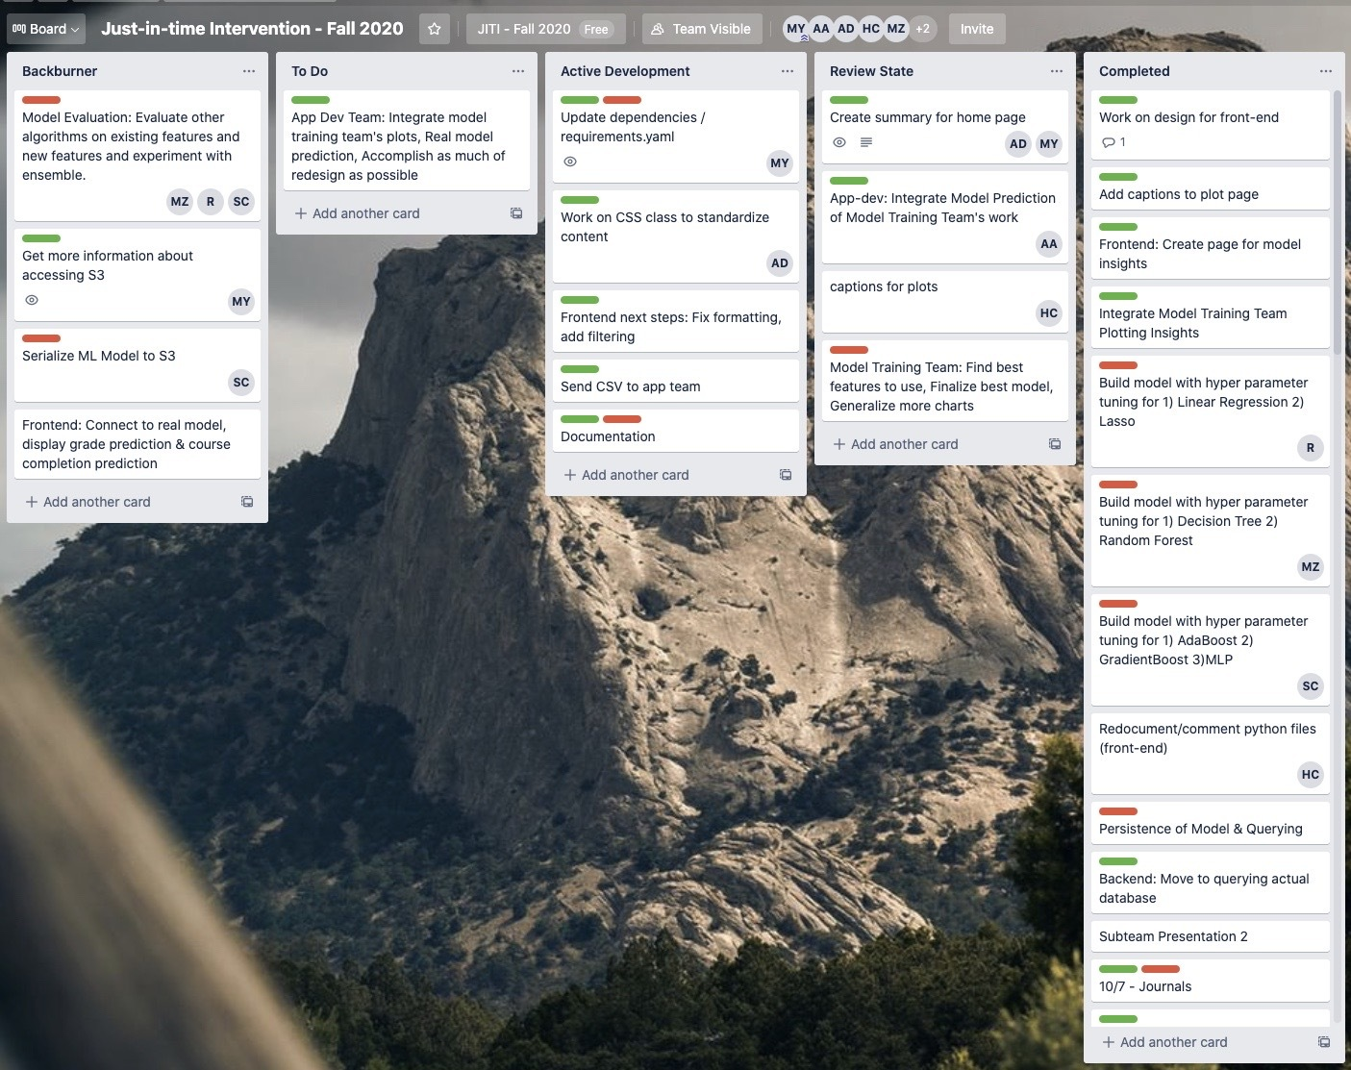
Logistical Accomplishments
Switched from Slack to Teams, awesome communication all-around
Implemented usage of Trello board
Weekly Trello board reviews as a team
Easy to stay up-to-date with what everyone is doing
Attendance
Near 100% sub-team meeting attendance!
Github code reviews and pull-requests

Slide 6
Overview of this Semester
Weeks 1 to 6
Ramping up on project (review of previous semester’s work, credentials, dataset, etc.)
Creating plans for this semester
Preliminary work on web app
Split up into sub-groups: Data modeling team and app development team
Weeks 7 to 10
Data Modeling Team: Data cleanup, null value removal, data exploration
App Development Team: Improved mock up website, continued work on front-end features and back-end work
Weeks 11 to now
Model training/evaluation and major app progress!

Slide 7
Data Modeling Team

Slide 8
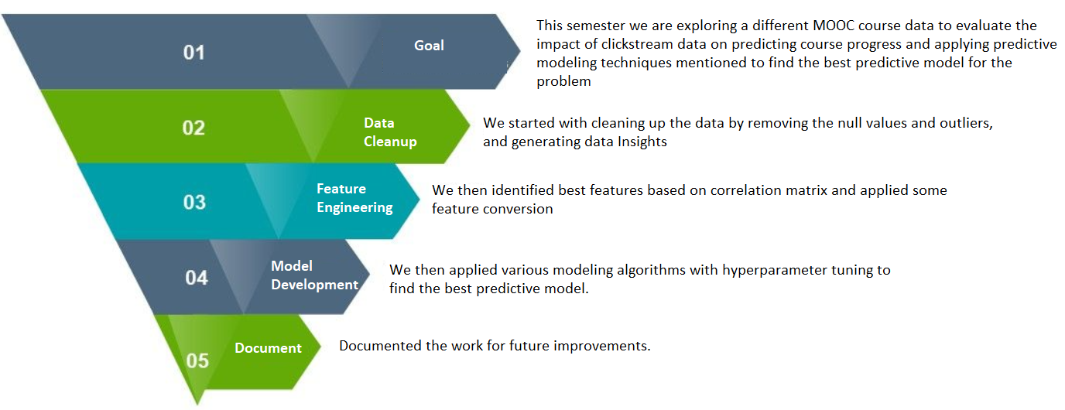
Overview of Work Done

Slide 9
Introduction to Model Training and Initial Efforts
This semester, we have a new exciting data set (due to database limitations)
Rather than predicting final grades, we are predicting course completion rates
Also trying to gain insights from non-supervised learning
LinearRegression
Train RMSE: 0.033
Lasso
Train RMSE: 0.034
Overall Linear models did not work very well.

Slide 10
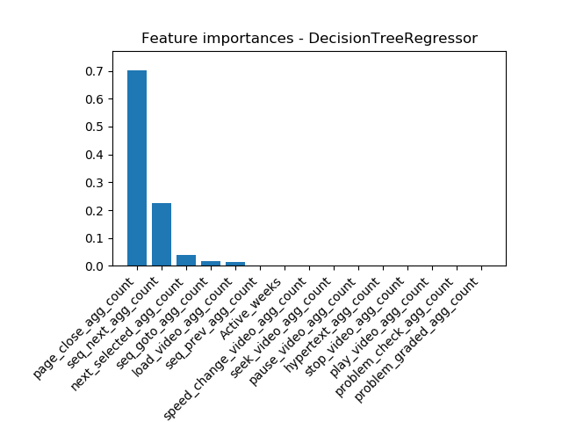
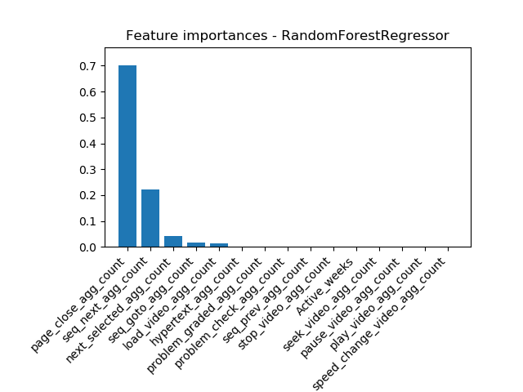
Tree Models
DecisionTreeRegressor
max_depth: 2, min samples in leaf: 1
RandomForestRegressor
max_depth: 5, min samples in leaf: 14
Similar result:
Page_close_agg_count
Seq_next_agg_count
Next_selected_agg _count
Seq_goto_agg _count
Load_video_agg count
Move from R to Python for better interpretation and alignment to the model pipeline

Slide 11
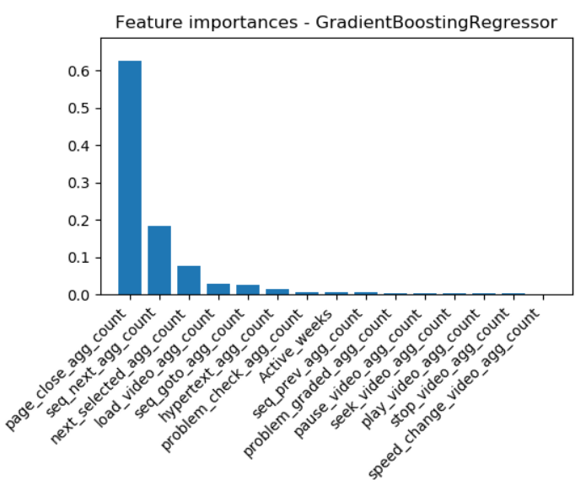
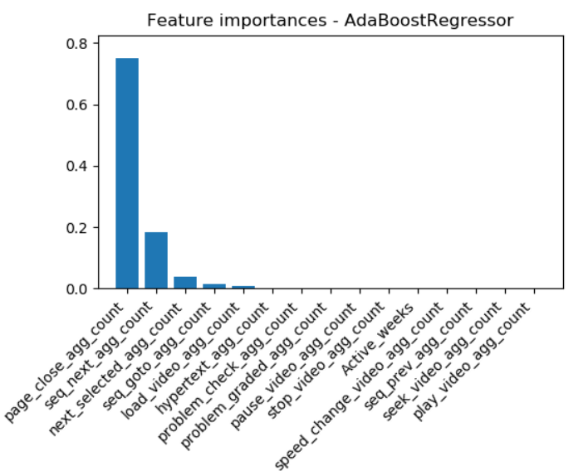
Ensemble and Other Models
BaggingRegressor
max_depth: 4, min samples in leaf: 14
Train RMSE: 0.0296
AdaBoostRegressor
max_depth: 4, min samples in leaf: 19
Train RMSE: 0.029
GradientBoostingRegressor
max_depth: 5, min samples in leaf: 1
Train RMSE: 0.018
KNN Regressor(to evaluate fast training)
k=11
Train RMSE: 0.027

Slide 12
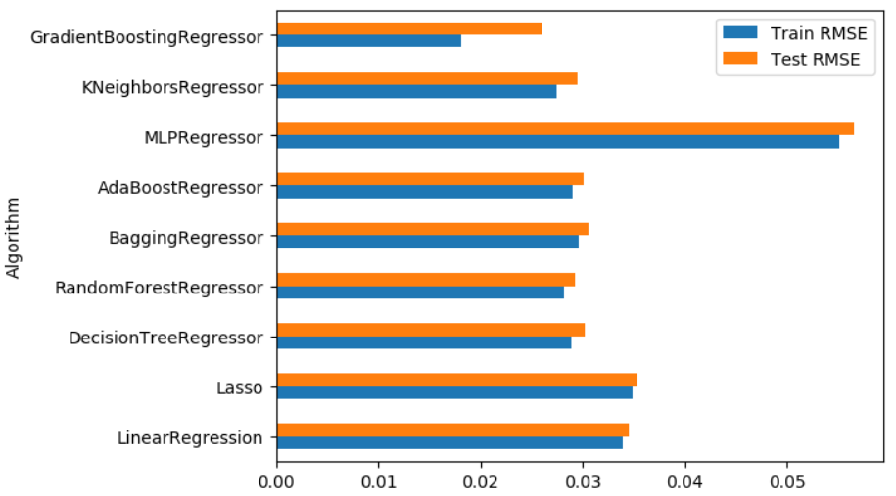
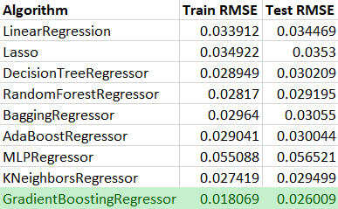
Final Model Selection & Results
Gradient Boosted trees worked best.
All others trees were close.
Linear Algorithms did not perform well.
Final RMSE: 0.018
The final model performed great for lower % progress values but did not perform well for higher % progress, indicating some bias in the model.
Sample output on Test Set
Original Progress: 0.04, Predicted Progress: 0.037
Original Progress: 0.88, Predicted Progress: 0.52

Slide 13
Comparison to Previous Work Done
Our project replicated much of the work from Garner & Brooks
We applied the predictive modeling techniques mentioned in the paper to find the best predictive model for the problem
Garner & Brooks found that using clickstream data and non-parametric tree-based models produced the most accurate predictions
Our findings align with this claim, with our best model being Gradient Boosting Regressor

Slide 14
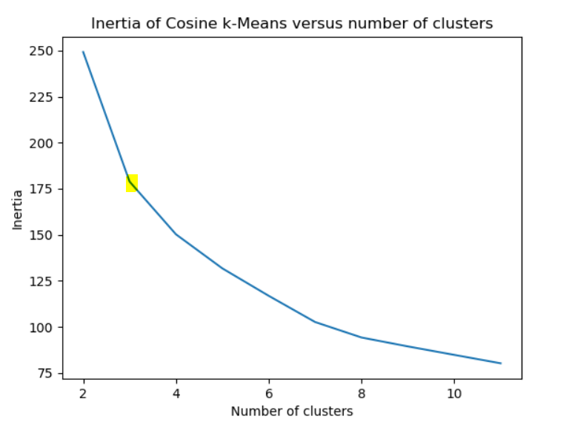
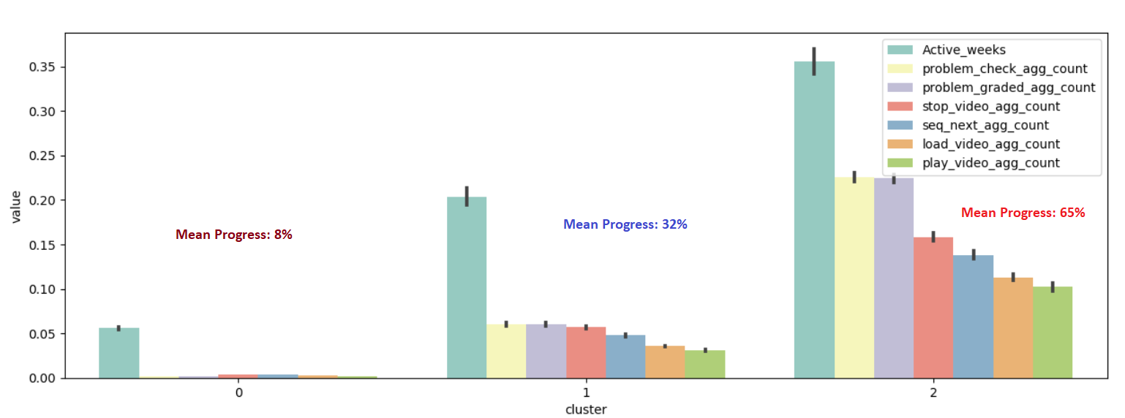
Unsupervised Learning
Ran multiple algorithms,
Selected Cosine k Means
Used Silhouette Score as the factor
Found 3 clusters using elbow method
Cluster shows interesting observation

Slide 15
Future Work
Further Analysis of Unsupervised Learning
Live Progress Track
Run the model in a real-time basis to predict students’ performance and provide necessary interventions.
Reduce the model bias
The current model not performs well with a higher percent of progress
Introducing data with higher percent of progress and refine the model
Validating model with more datasets and previous data source
Formalizing Model for Scalability
Test/Automate machine learning pipeline on other classes
Put model into S3 bucket for scalable querying

Slide 16
Web Development Team

Slide 17
Web Development Team : Front-end Overview
Redocumented all the front-end files
Removed redundancies / unneeded code/comments
Improved table-data page
Added Resources Page
Added Completion % Page
Made advanced mock-up (end-goal mock-up)
Added sidebar for better navigation
Separated App.py into multiple files (was starting to grow out of hand)
New home page!

Slide 18
Web Development Team : Demo!
Added a resources page that can be expanded upon
Currently has these 3 links but can later add different things such as emailing encouragement and whatnot
New home page that can be expanded on in the future
Added a completion % prediction page for the model that the model team had worked on this semester
Connected to real database and real model to display predicted grade as well as current stats in a scrollable table
http://127.0.0.1:8050/

Slide 19
Back-end: Progress since last presentation
Updated dummy model so columns on which the model is applied to is known (instead of randomly picking 7 columns)
Added actual model worked on by model team so frontend is able to display information based on inputted student id
Spent time helping frontend with restructuring app.py into multiple pages

Slide 20
Back-end: Semester Overview
What we are working on now:
Finishing up documentation and refactoring to implement best practices (i.e. creating a class for the model) to help make start of next semester seamless
Our goals for the semester were:
Connect web app with C21U DB (Completed)
Write functions to assist with query as needed by the Front-end (Completed)
Display output of real model (Completed)
Build email notification that triggers when predicted completion drops below a threshold (Reach Goal - Not started)

Slide 21
Next Steps: Future Semesters
Intervention Ideas
More ideas for just-in-time-intervention - (email triggers)
Front-end
Make it look more like the final mock-up (responsiveness graph, media query)
Add more resources / Decide on how we want to intervene (more holistic data)
Back-end
Integrate into Canvas
Integration of other models that future model-training teams create
Auto-ingest models by class
Connect to models stored in cloud
Misc
Survey users to get feedback
Come up with additional features

Slide 22
Final Summary
Model Training Team
Despite limitations on prior data, did a great job exploring new data and drawing both useful insights from completion percentage rates
New members learned a lot about how data analysis is done, starting with obtaining the data, to data clean-up, to data engineering, to model training and finally evaluation
Web Development Team
Great planning effort
Massive front-end and back-end efforts, fully connected to C21U database and querying like a production app!
Proper agile development practices and a lot of great communication
Solid groundwork laid out for future plans

Slide 23
Thank you!!

